Slide 1
Project name Ai based patient monitoring robot
Project instructor sir: Mohammad Ashrafuzzaman Khan
Students: Name: Debnath Banik
Id:1410118643
Idea: to make a robot that may can do task like a helping assistant of doctors
and nurse to provide more facilities in medical sector
Basic functions of the bot may include:
1.Monitor patient health with various sensors
2.Creat a large history of patient
3.Do many work or give service to Patient as asked by patient(like bringing water , food etc )
4.Inform or call doctor, nurse after health monitoring
4.Face recognition and enrollment new patient
5.Conversate with patient, doctor and nurse
6.Can go patient to patient
7.May Give service like intercom with video to conversate with doctor any time

Slide 2
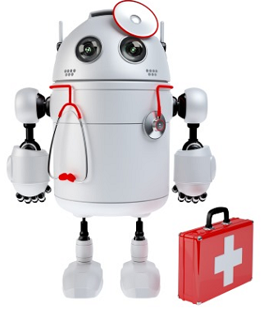
The reasons
limited monitoring system in hospital specially in general wards
for frequent patient monitor service and a helping assistant for nurse, ward boys and duty doctors
Covid hospital patients are isolated and facilities are very limited often seems to self assist during pandemic
I.C.U limitation
To make a easier Doctor to (patient or junior doctor or nurse) communication through video call
And to store patent health history or data in large for analyze

Slide 3
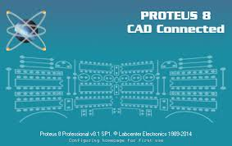
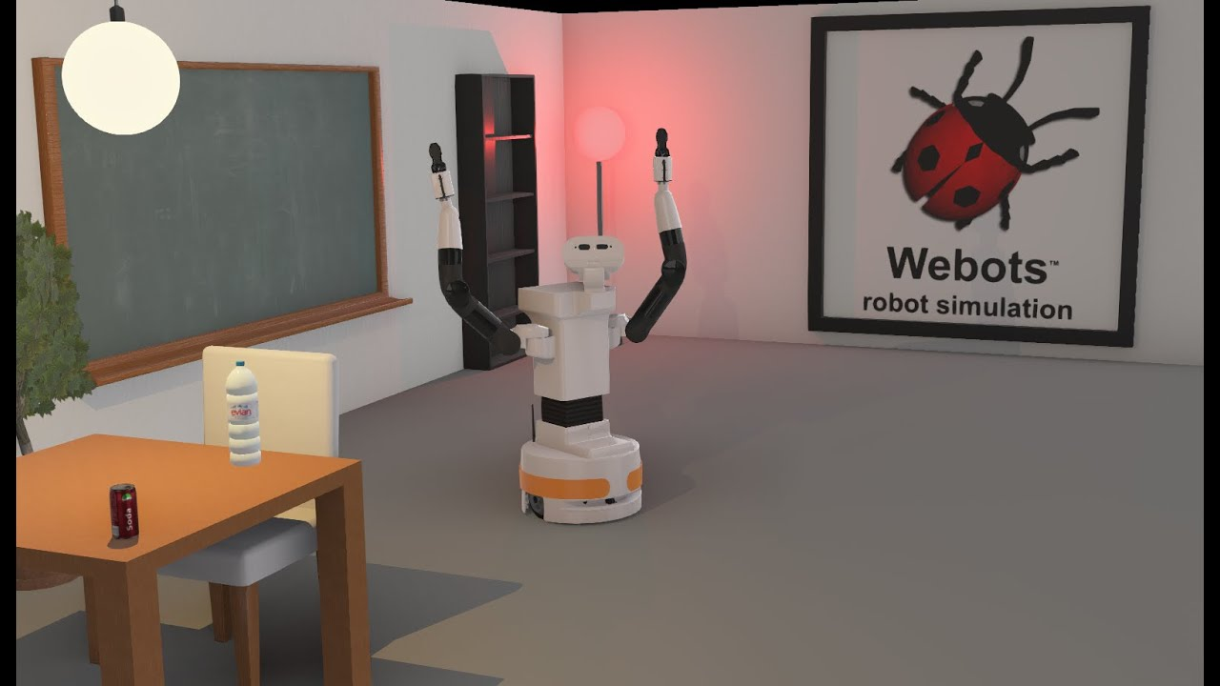


Probable working Steps
Mechanical body animate by solid works , webots or other software
Body build according to design
Electronic circuit simulate by proteus
Electronic part controlled by Arduino
For ai part (image prosses ,road prosses ,data store etc.) processed by raspberry pi

Slide 4

Possible outcomes
An ai based robot that may help in monitoring patient to more larger scale
Patient treatment may become more better and easier
May help the hospital system in such pandemic situation
Patient may get more facilities by this bot
Thank you

